Slide 1




Critical Thinking S1 2023
Dr. Iwan Williams
Email: iwan.williams1@monash.edu

Slide 2
Lecture 2.1:
Evaluating arguments

Slide 3
Review quiz!

Slide 4
Recap
An argument is a set of claims of which one is a conclusion and the remainder are premises, intended as support for the conclusion
P1. Car use is damaging to the environment.
P2. Reducing car journeys would reduce damage to the environment.
P3. We should do what we can to protect the environment.
Therefore,
C. We should use less cars.

Slide 5
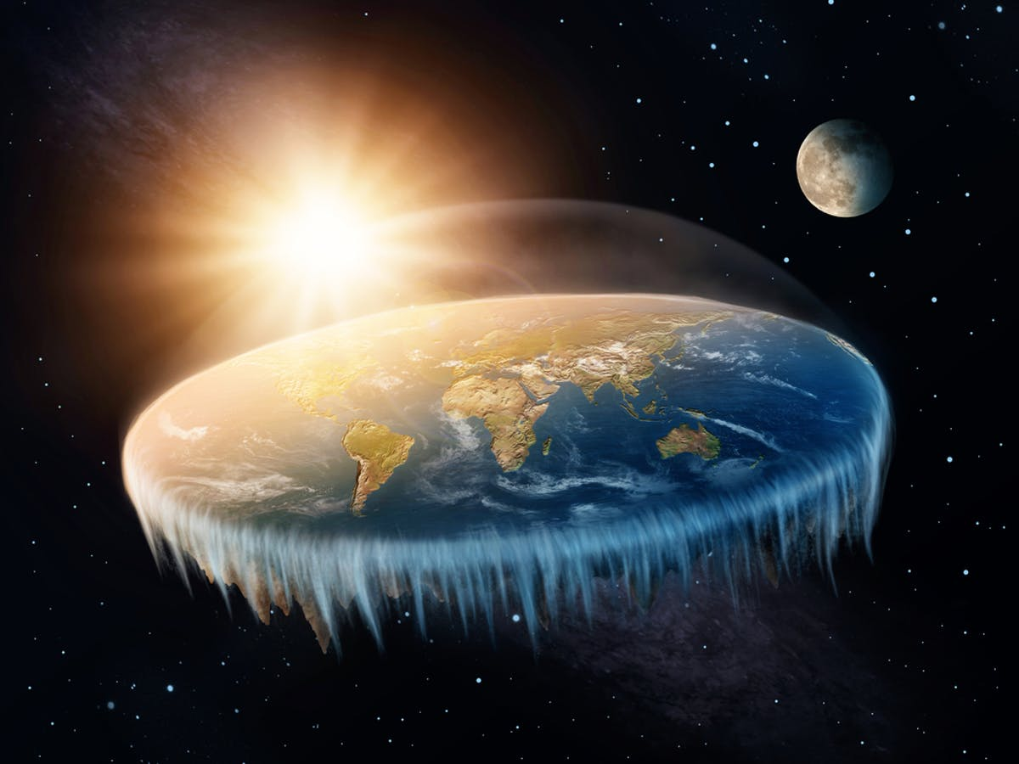

What makes an argument good?
An initial thought:
A good argument is one that convinces the audience that the conclusion is true.
Two problems:
People are often convinced by garbage arguments.
People often fail to be convinced by objectively good arguments.
Notes:
But the problem with this thought is that many garbage arguments are convincing.

Slide 6
What makes an argument good?
An initial thought:
A good argument is one that convinces the audience that the conclusion is true.
A better thought:
A good argument is one that the audience should be convinced by because it provides an objectively good reason for accepting the conclusion.
Notes:
But the problem with this thought is that many garbage arguments are convincing.

Slide 7
What makes an argument good?
Remember: all arguments attempt to provide reasons for thinking some claim (the conclusion) is true.
Two features of a good/successful argument:
All the premises are acceptable as true.
The premises support the conclusion.

Slide 8
All the premises are acceptable as true.
How might we find out whether a premise is true?
Does the premise come from an expert source or a reliable authority?
Could you easily check whether the premise is true by looking it up in a reference book or other reliable source?
Does the premise contradict something else you know to be true for good reasons?
If the premise is a generalisation, can you think of any counter-examples?
(We’ll look at this more in Class 3)

Slide 9
What makes a good argument good?
Two features of a good/successful argument:
All the premises are acceptable as true.
The premises support the conclusion.

Slide 10
The premises support the conclusion.
To say that premises support a conclusion means that:
If the premises were true, then we’d have a good reason to accept the conclusion.
Two types of support we’ll look at today:
Inductive support
Deductive support (aka validity)

Slide 11
Inductive support
Premises provide inductive support to a conclusion when the following condition is met:
If the premises were true, then it would be very likely that the conclusion is true.
Examples:
Practically every house on South Street is falling apart. Sherry lives on South Street. Her house is probably falling apart
Almost every windstorm in this area comes from the north. I can see a big cloud of dust in the distance. A new windstorm is coming from the north.
When I eat shellfish I usually get sick. I just ate some shellfish. I’m going to get sick.

Slide 12
Deductive support (aka validity)
(One of the central concepts in critical thinking).
An argument is valid (the premises deductively support the conclusion) when the following condition is met:
If the premises of the argument were true, the conclusion must also be true.
P1. Socrates is human.
P2. All humans are mortal.
Therefore,
C. Socrates is mortal.
P1. Elizabeth owns either a Honda or a Saturn.
P2. Elizabeth does not own a Honda.
Therefore,
C. Elizabeth owns a Saturn.

Slide 13
Deductive support (aka validity)
Three ways of saying the same thing:
An argument is (deductively) valid if…
…the truth of the premises would guarantee the truth of the conclusion.
…there is no possible situation in which the premises are true but the conclusion is false.
…the argument is truth preserving: if you start with true premises you end up with a true conclusion.

Slide 14
Two types of support
DEDUCTIVE SUPPORT (VALIDITY): If the premise were true, the conclusion must be true.
P1. I can’t answer your emails until I’ve had coffee.
P2. I haven’t had any coffee yet.
Therefore,
C. I can’t answer your emails yet.
INDUCTIVE SUPPORT : If the premise were true, the conclusion would be very likely to be true.
P1. The road was wet this morning.
Therefore,
C. It rained last night.
Notes:
If I can answer your emails – then I must have had coffee (p2 is false) – or p1 is false! Deductive validity doesn’t usually pertain to arguments in the real world – the kind of validity we are most concerned with in this unit is inductive validity. We’ll spend some time on deductive validity to help us practice the formal features of good reasoning.

Slide 15
Deductive support (aka validity)
P1. The prime minister’s dog is infested with fleas.
P2. All fleas are bacteria.
Therefore,
C. The prime minister’s dog is infested with bacteria.
The conclusion follows from the premises, valid
P1. Colette owned a dog.
P2. All French bulldogs are dogs.
Therefore,
C. Colette owned a French bulldog.
The conclusion doesn’t follow from the premises, invalid

Slide 16
Deductive support (aka validity)
Validity is about the logical structure of the argument – the connection between the premises and the conclusion – not about the actual truth-values of premises or the conclusion!
So an argument can have premises and a conclusion that are false, but still be valid.

Slide 17
Examples
Valid argument with false premises and a true conclusion
P1. All monkeys smell like bananas (F)
P2. Some monkeys are university students (F)
Therefore,
C. Some university students smell like bananas (T)
Even though both premises false, if they were both true, the conclusion must also be true.

Slide 18
Examples
Valid argument with a false premise and a false conclusion
P1. Covid-19 is a coronavirus (T)
P2. All coronaviruses are deadly to all their host organisms (F)
Therefore,
C. Covid-19 is deadly to all its host organisms (F)
Even though one premise is false, if they were both true, the conclusion must also be true.

Slide 19
Examples
Valid argument with false premises and a false conclusion
P1. The prime minister of Australia must be younger than 35 (F)
P2. Scott Morrison is prime minister of Australia (F)
Therefore,
C. Scott Morrison is younger than 35 (F)
Even though both premises are false AND the conclusion is false, it’s still the case that if the premises were both true, the conclusion must also be true.
The take home message is that an argument can be valid even if its premises and/or conclusion are false.

Slide 20
Examples
P1. Anything that has an engine needs oil.
P2. Cars need oil.
Therefore,
C. Cars have engines.
An argument can have true premises and a true conclusion and yet be invalid!
Remember, validity has nothing to do with the actual truth of the premises or conclusion. Rather it has to do with the connection between the premises and the conclusion.
We can sometimes be fooled into thinking that an argument is valid if we think that it’s conclusion and premises are plausible. (confirmation bias)

Slide 21
What makes a good argument good?
Two features of a good/successful argument:
All the premises are acceptable as true.
The premises support the conclusion.

Slide 22
Lecture 2.2:
Critical thinking mindset
Notes:
Two elements of critical thinking: reasoning skills and mindset.
Already introduced a number of reasoning skills
But simply learning these skills is not enough, due to our deeply ingrained biases, which can lead us to deploy these skills in an uneven and unfair way.

Slide 23
What is a cognitive bias?
P1. Anything that has an engine needs oil.
P2. Cars need oil.
Therefore,
C. Cars have engines.
A cognitive bias is a systematic error in thinking often due to implicit psychological shortcuts.

Slide 24
Confirmation Bias
The tendency to notice or focus on potential evidence for our pre-existing views, and to neglect or discount contrary evidence.
Confirmation bias can be present without an underlying motive to have the belief in the first place.
David Manley – Reason Better
Notes:
Unlike motivated reasoning…

Slide 25
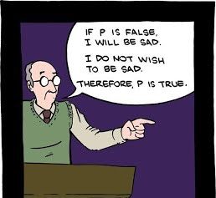
Motivated Reasoning
Forming or maintaining a belief at least partly because, at some level, we want it to be true.
94% of college professors thought they did "above-average work“ (Cross 1977).
93% of American drivers rated themselves better than the median driver (Svenson 1981).
Notes:
These examples of biases point to a more general point: one of the barriers to being good critical thinkers is our mindset – our habits and dispositions around forming and updating our beliefs.

Slide 26
Julia Galef on Scout vs Soldier Mindset

Slide 27

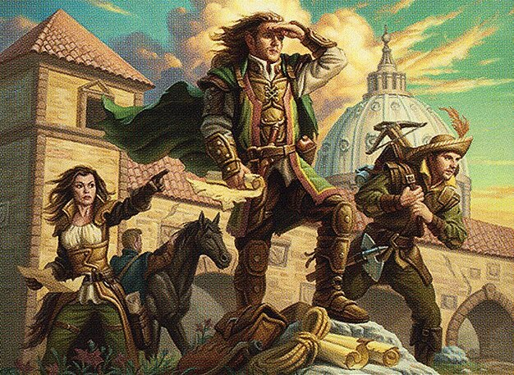
Soldier Mindset
Scout Mindset
Goal is to show that my beliefs are the right ones.
New information that challenges something I believe is seen as a threat to be neutralized.
Goal is to arrive at more accurate beliefs.
New information that challenges something I believe is seen as an opportunity to update my beliefs.
Notes:
Soldier mindset is to WIN at all costs.
If you (and your side) get attacked you need to defend yourself.
If you spot a weakness in the enemy you are duty bound to exploit it.
Your job is to defeat the enemy!
contrast the soldier to the Scout. The scout’s role is not to attack or defend but to learn (to understand). The scouts job isn’t to accumulate information that will make the general happy, but to accurately report on the way things actually are.
might hope there’s a bridge over the river, won’t help to report optimistically that there is.
maps the terrain and lists potential obstacles and aims for total accuracy - to represent the territory as it actually is.
Adopting the mindset of a scout is extremely hard.
Partly because our educational systems and our political and social structures PRIME us to be soldiers. ‘Debate’ is about winners and losers not about getting closer to the truth.
And partly because it can often feel like we are adopting the scout mindset and evaluating arguments in an impartial and unbiased manner, even when we aren’t.

Slide 28
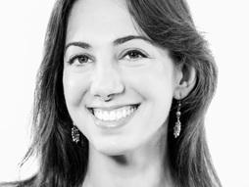
Cultivating the scout mindset
Step 1: We need to change the way we think about being wrong.
… we need to learn how to feel proud instead of ashamed when we notice we might have been wrong about something. We need to learn how to feel intrigued instead of defensive when we encounter some information that contradicts our beliefs.
– Julia Galef

Slide 29
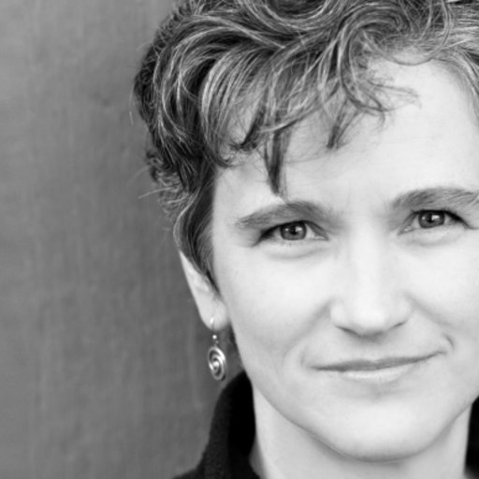
Cultivating the scout mindset
Step 2: We need to fine tune our understanding of our own biases. Without an understanding of our own biases we are prone to over-estimating the strength of our reasons.
It is not our biases that are our biggest stumbling block; rather it is our biased assumption that we are immune to bias. —Cynthia Frantz, 'I AM Being Fair’
Notes:
So moving forward, bear this in mind: the tools we’re giving you in this course are not tools to convince people, to win debates, to defeat your opponents, but tools for communicating your reasoning, and working together to converge on a clearer picture of reality.

